Slide 1

Telecom Customers Churn Analysis
By
Sanskruti Patil and Jidnyasa Baviskar

Slide 2
Approach To Prove The Business Objective :
Identify churn patterns among different customer segments such as gender, senior citizens, and contract types.
Analyze relationships between churn and key factors like monthly charges, tenure, and internet service type.
Compare churn behavior across different services and payment methods.
Measure churn rate and its impact on revenue to understand financial implications.
Provide insights and recommendations that can help improve customer satisfaction and loyalty.

Slide 3
Objective of the business :
Measure overall and segment-level churn rate across customer cohorts.
Enable data-driven decisions to reduce churn, increase retention, and recover lost revenue.
Quantify revenue at risk (lost revenue) from churned customers.
Compare churn behaviour by contract type, payment method, gender, and internet service.
Track key KPIs: Total Customers, Churn Rate, Total Revenue, Lost Revenue, Churned Customers.
Provide filters and slicers for interactive root-cause exploration by business users.

Slide 4
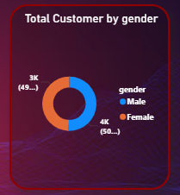
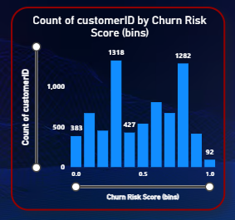
Key Visuals:
The chart shows an almost equal split 50.48% male and 49.52% female customers.
This means gender has minimal impact on customer churn in this dataset.
male and female customers face similar service experiences and challenges.
There is a significant number of customers with mid-range churn risk
(bins around 0.4–0.7 seem high).
There are fewer customers at the extremes (very low risk near 0.0 and
very high risk near 1.0) though there are some at high risk (the bin at 1 has
a non-zero count, though it's the lowest in your sample).
The distribution doesn’t look strongly skewed to the “safe” side; instead, it seems
more concentrated in the medium-risk range.

Slide 5
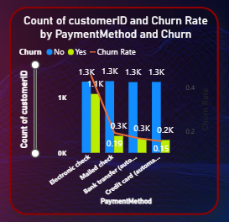
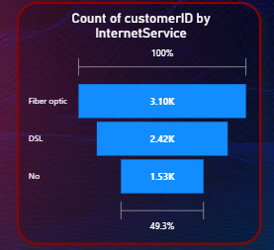
Key Visuals:
Electronic and Mailed Checks Have Higher Churn:
Customers paying by electronic check and mailed check show
noticeably higher churn rates compared to other methods.
Bank Transfers & Credit Cards Retain Better:
Customers using bank transfer or credit card (automatic) have
lower churn, indicating more stable payment behavior.
Actionable Opportunity: Encouraging customers to switch to automatic/online payments could help reduce overall churn.
Fiber Optic is the most used service with 3.1K customers, indicating high demand or availability.
DSL serves 2.4K customers, showing moderate adoption compared to Fiber Optic.
1.5K customers have no internet service, representing a potential upsell opportunity.

Slide 6
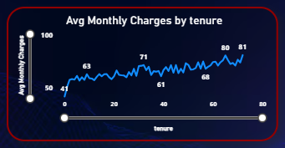
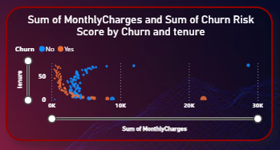
Key Visuals:
Monthly charges tend to increase as customer tenure
increases. Early in the customer lifecycle (low tenure), average
charges are lower (around ~41). As tenure grows, the average
monthly charges generally rise and fluctuate around higher values
(60s–70s), reaching around ~80 by high tenure.
There is a positive upward trend overall. This suggests that longer-tenured
customers are paying more on average each month than newer customers.
Customers with low tenure and high monthly charges are more likely to churn.
Points representing churned customers (often shown in a different color) cluster toward lower total monthly charges and shorter tenure meaning they haven’t been with you long but are paying relatively high monthly charges.

Slide 7
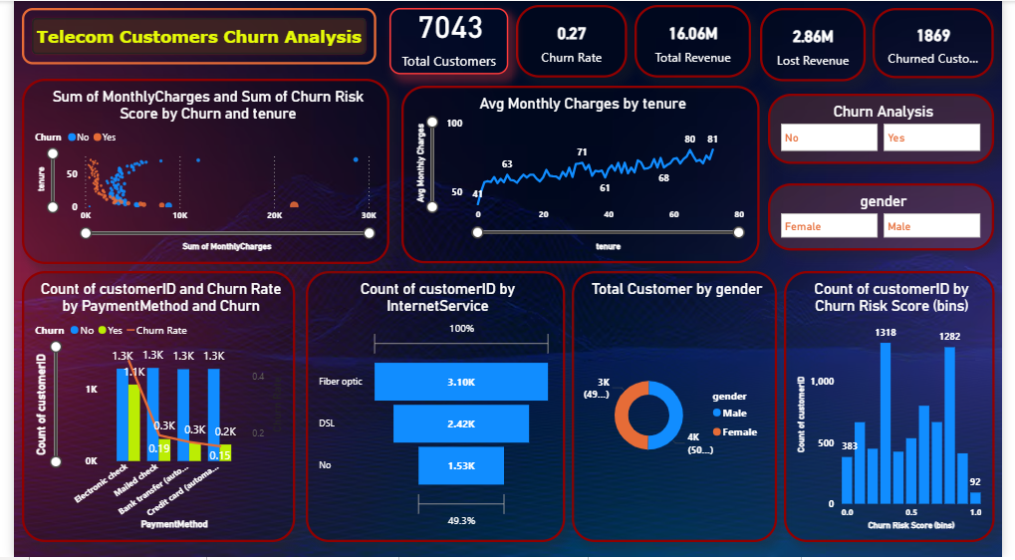
DASHBOARD

Slide 8
Link to The Dashboard
Telecom Customers Churn Analysis - Churn Customer Project1 - Power BI
Telecom Customers Churn Analysis - Churn Customer Project1 - Power BI

Slide 9
Conclusion :
Churn is significantly impacting revenue 27% churn rate has already contributed to nearly $2.86M in
lost revenue.
High churn risk clusters in specific segments — especially among newer customers with high monthly
charges and those using electronic or mailed checks as payment methods.
Customers on automatic payments (credit card/bank transfer) and longer-tenured customers show
better retention and higher lifetime value.
Longer tenure correlates with higher average monthly charges, indicating that customers who stay longer
spend more — underscoring the value of retention.

Slide 10

THANK YOU

